Slide 1

PUBLIC LAW: Lecture 4
THE RULE OF LAW

Slide 2
Today’s Plan
Reminder: Formative Assessment will be released this Thursday and submission deadline is Friday. No late submissions!
What is the rule of law and what is its significance?
What is the history of the rule of law?
Formal and substantive theories of the rule of law
How have the courts interpreted the rule of law?

Slide 3
The Rule of Law: Definition
Not a legal rule but a moral principle
No single meaning or definition
Aristotle: ‘The rule of law is better than that of any individual.’
CRA 2005 S1:
  ‘The Act does not adversely affect—(a) the existing constitutional principle of the rule of law, or (b) the Lord Chancellor’s existing constitutional role in relation to that principle.’
R (UNISON) v Lord Chancellor [2017] UKSC 51, [68] (Lord Reed):
‘At the heart of the concept of the rule of law is the idea that society is governed by law.’

Slide 4
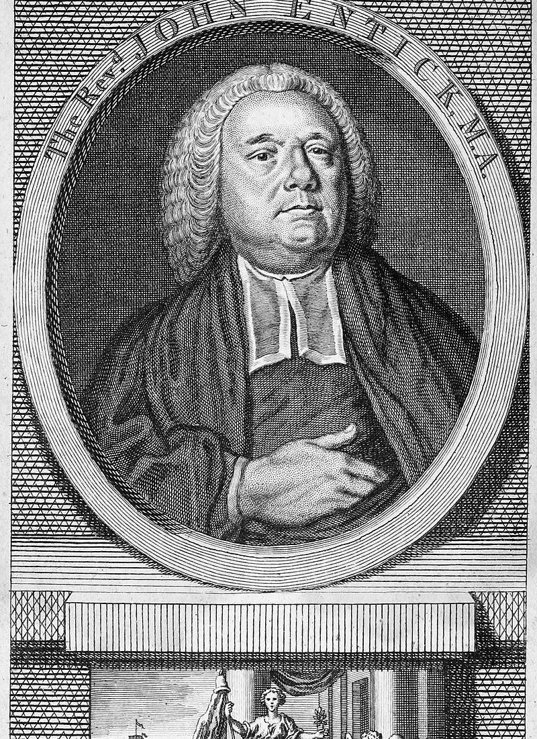
History of the Rule of Law
Aristotle ‘Politics and Athenian Constitution’ – shift to rule by the King
Magna Carta 1215 and the Bill of Rights 1689
Entick v Carrington (1765) 95 ER 807
  Lord Camden CJ [817]: ‘if it is law, it will be found in our books. If it is not to be found there, it is not law.’
R (Miller) v Prime Minister [2019] UKSC 41
  [31]: ‘Nevertheless, the courts have exercised a supervisory jurisdiction over the decisions of the executive for centuries.’
  [32] – reference back to Entick

Slide 5
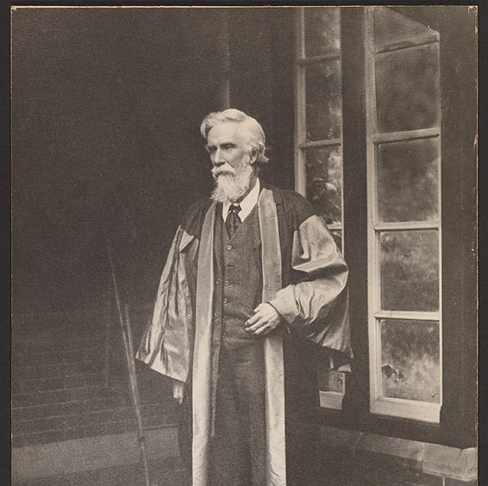
A V Dicey on the Rule of Law
‘One of the most marked peculiarities of English life.’
Three main principles
  No man is punishable except for a distinct breach of the law.
  No man is above the law.
  The constitution is a result common law.

Slide 6

No punishment without a breach of law.
A and others v Secretary of State for the Home Department [2004] UKHL 56 (the Belmarsh Detainees case)
s23 Anti-Terrorism, Crime and Security Act 2001→ indefinite detention of foreign prisoners without trial
Article 15 ECHR → used to suspend Article 5’s Right to Liberty
Strict conditions met? NB: National security.
Aimed at foreigners only
“indefinite imprisonment without charge or trial is an anathema in any country which observes the rule of law.” (Lord Nicholls)

Slide 7
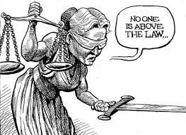
No man is above the law.
M v Home Office [1993] UKHL 5
M deported to Zaire* in breach of court order
Court orders his return to the UK
Home Secretary decides otherwise
Home Secretary in contempt of court
“[T]he object of the exercise is not so much to punish an individual as to vindicate the rule of law by a finding of contempt.” (Lord Woolf)
*now Democratic Republic of the Congo
R v Mullen [2000] QB 520 CA – the means do not justify the ends.

Slide 8

The constitution is a result common law.
Jackson v AG [2005] UKHL 56 Lord Steyn at [102]
  [T]he supremacy of Parliament is … a construct of the common law. The judges created this principle.”
Embeds constitution in fabric of society
  Concrete situations
  Practical remedies in the hands of the courts
  Individual rights as the basic perspective

Slide 9
Formal and Substantive Theories
Formal
address the manner in which the law was promulgated
the clarity of the ensuing norm
the temporal dimension of the enacted norm
not emphasis on content of the law itself
North Korea, Nazi Germany
Substantive
acceptance of the principles suggested by formal theories
Goes beyond that - the content is important
The rule of law requires that the law respect certain moral conditions.
Dworkin: because the law is fundamentally about providing a just society, the rule of law demands that laws accord with a theory of justice.
Laws create and govern a society, and individuals must have their rights defended within this fundamentally coercive system.
Lord Bingham: the rule of law requires human rights protection.
TRS Allan: Parliamentary sovereignty is based on certain conditions, e.g. liberty, and they cannot be lawfully breached.
This might mean limiting Parliamentary Sovereignty: what if it passed law that breached the rule of law, understood in this broad way?

Slide 10

Formal Theories of the Rule of Law

Slide 11

Joseph Raz ‘the rule of law and its virtue’ in ‘the authority of law: essays on law and morality’ 1979
The rule of law is a formal matter.
It does not necessarily relate to ideas of the good life, beyond perhaps enshrining them into law.
Law is distinct from politics, otherwise ‘law’ ceases to have a discrete meaning:
To be valid, the law must be passed using the correct procedures.
Law must be able to guide conduct and enable you to ‘plan your life’ (but it may be an awful life!).
Laws must be: prospective, transparent, enforced by an independent judiciary, provide for limited executive discretion.
“the rule of law is just one of the virtues which a legal system may possess and by which it is to be judged” → should not try to read into it other considerations about democracy, human rights, and social justice.
http://fs2.american.edu/dfagel/www/Philosophers/Raz/Rule%20of%20Law%20and%20its%20Virtue_%20%20Joseph%20Raz.pdf

Slide 12

Lord Bingham
‘The Rule of Law’ (2007) 66 CLJ 67
Seven of his eight principles
Law should be accessible, clear and predictable;
Questions of legal right and liability should be decided by application of the law;
The law of the land should apply equally to all, except when objective difference requires differentiation;
Public officials should exercise their powers in good faith, and not exceed their powers;
A method should be provided, at reasonable cost, to resolve civil disputes;
Adjudicative procedures must be provided by the state should be fair;
The rule of law requires the state to comply with its obligations in international law.

Slide 13
Formal rule of law in context
Judicial review (administrative law) secures ‘equality before the law’
Legislation is usually made public in good time.
Our law tends to be intelligible - at least to people trained in understanding the law.
Our laws do not usually have retrospective effect (see your English Legal System notes).
Court proceedings are, unless there are exceptional circumstances, accessible to the public.
The UK … normally abides by its international law obligations …

Slide 14
Formal rule of law in case law
It is very simple to identify judicial decisions which enforce the ‘core’ rule of law.
Government must operate under and within the law: see generally judicial review lectures in Term 2.
  Entick v Carrington (1765) 19 St Tr 1029.
  Padfield v Minister for Agriculture, Fisheries and Food [1968] AC 997
  Anisminic Ltd v Foreign Compensation Commission [1969] 2 AC 147 – ouster clause
  R (Miller) v Secretary of State for Exiting the European Union [2017] UKSC 5.
  The ‘GCHQ’ case: see next week’s lecture.
Clarifying the law: R (Purdy) v DPP [2009] UKHL 45 (is the prosecutorial policy on assisted suicide ‘prescribed by law’ within the meaning of the ECHR?).
The correct processes must be followed in order for the law to be valid: remember Pickin and R (Jackson) v Attorney General.

Slide 15
Substantive Theories of the Rule of Law

Slide 16
Substantive rule of law in case law
Evidence that courts are sketching out a more substantive understanding of the rule of law that might serve as a limit on Parliament’s intentions and perhaps even sovereignty
R v Secretary of State ex parte Pierson [1998] AC 539, 591 per Lord Steyn
“Unless there is the clearest provision to the contrary, Parliament must be presumed not to legislate contrary to the rule of law. And the rule of law enforces minimum standards of fairness, both substantive and procedural.”
Jackson v AG [2005] UKHL 56 at [103]-[107] per Lord Hoffman
“It is no longer right to say that its freedom to legislate admits of no qualification whatever … the rule of law enforced by the courts is the ultimate controlling factor on which our constitution is based.”
R (on the application of Al Rawi and others) v Secretary of State for Foreign and Commonwealth Affairs and another [2006] EWCA Civ 1279 [146]
‘’ …particularly since the HRA came into force, our conception of the rule of law has been increasingly substantive rather than merely formal or procedural.’’

Slide 17
R v Secretary of State for the Home Department, ex parte Simms [2000] 2 AC 115
The Home Secretary, through rules issued under the Prison Act 1952, prohibited the publication of interviews between a journalist and a prisoner protesting innocence.
Journalist claims this was a unlawful (note: there is no HRA at this point).
Appeal allowed on the basis that it breached freedom of speech and harmed the process of justice.
The law should protect basic rights and in the case of ambiguous statutory language, there is a presumption that Parliament did not wish to interfere with these – here there was an ‘exorbitant’ one (Lord Steyn).

Slide 18
Lord Hoffmann and the principle of legality: Simms, p. 132
Parliamentary sovereignty means that Parliament can, if it chooses, legislate contrary to fundamental principles of human rights. The Human Rights Act 1998 will not detract from this power. The constraints upon its exercise by Parliament are ultimately political, not legal. But the principle of legality means that Parliament must squarely confront what it is doing and accept the political cost. Fundamental rights cannot be overridden by general or ambiguous words. This is because there is too great a risk that the full implications of their unqualified meaning may have passed unnoticed in the democratic process. In the absence of express language or necessary implication to the contrary, the courts therefore presume that even the most general words were intended to be subject to the basic rights of the individual. In this way the courts of the United Kingdom, though acknowledging the sovereignty of Parliament, apply principles of constitutionality little different from those which exist in countries where the power of the legislature is expressly limited by a constitutional document.

Slide 19

R (Evans) v Attorney-General [2015] UKSC 61
King (Prince at the time) Charles writes letters to ministers. Their publication was ordered by an information tribunal. The Attorney General disagreed.
Can the Attorney General legally use s53 Freedom of Information Act 2000 to veto the release of King Charles’ letters to ministers, essentially overturning the judgment, on grounds of public interest?
He can do so if ‘he has on reasonable grounds formed the opinion that, in respect of the request or requests concerned, there was no failure’ to comply with s1 of the Act.
Lord Neuberger: it is the heart of the rule of law that judicial decisions cannot be set aside by the executive. Section 53 cannot be used to do this, especially since it is not explicitly granting that power. That is not reasonable.

Slide 20
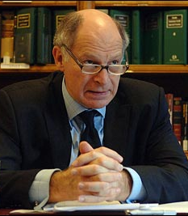
Lord Neuberger’s judgment in Evans, [52]-[59]
He emphasises the importance of the rule of law – in the sense that the government must respect the law – with reference to settled cases:
The decision is ‘formalist’ in that it is about enforcing government under the law.
For the AG to make his certificate, in a way that overturned a Tribunal’s decision because he disagreed with it, Parliament’s language had to be ‘crystal clear’ that the FOIA 2000 allowed the Attorney General to overturn a court decision just because he disagreed with it.
It was not sufficiently clear.
But his subtext is that the courts determine what the rule of law requires.
“it is a basic principle that a decision of a court is binding as between the parties, and cannot be ignored or set aside by anyone including (indeed it may fairly be said, least of all) the executive.” [52]
“it is also fundamental to the rule of law that decisions and actions of the executive are … reviewable by the court at the suit of an interested citizen.” [52]

Slide 21
Two views of Lord Neuberger’s judgment
Elliott
Ekins and forsyth
What can only be described—not necessarily pejoratively—as radical interpretive surgery pursuant to the principle of legality.
Parliamentary legislation must be interpreted in light of existing constitutional principles.
Perhaps Lord Neuberger crossed the line, but perhaps he did not.
“a strained and implausible interpretation”
“The basic problem with the majority judgments is that they confuse the rule of law with the rule of courts and discount the constitutional importance of political accountability. It is not contrary to the rule of law to authorise a minister to overrule a tribunal’s decision about the public interest in disclosing official information, for which view he or she is responsible to Parliament.”

Slide 22
Lord Mance, Lord Hughes, and Lord Wilson in Evans
Each argues that the key to this case is whether the AG acted ‘reasonably’. That is what the law says.
Lord Mance’s reasoning:
  What does ‘reasonable’ mean?
    In this context, the rule of law implications are so significant that the AG would need exceptionally good reasons. He had not shown this; he didn’t even respond to all of the Tribunal’s concerns.
Lord Hughes and Lord Wilson:
  ‘The rule of law is of the first importance. But it is an integral part of the rule of law that courts give effect to Parliamentary intention. The rule of law is not the same as a rule that courts must always prevail, no matter what the statute says’ (Lord Hughes, [154]).
  What does ‘reasonable’ mean?
    It means the normal administrative law standard; has he given cogent reasons? Is it so unreasonable that no reasonable AG would make thatt decision?
    Yes, he has; it does not matter that they are not the same as the Tribunal.
    See further ‘irrationality’ lectures.

Slide 23
Summary
Rule of law does not have a single meaning.
It is a moral principle.
3 main principles identified by Dicey
Formal theories of the rule of law focuses on the procedures.
Substantive theories of the rule of law focuses on the content.
Evidence that courts are sketching out a more substantive understanding of the rule of law that might serve as a limit on Parliament’s intentions and perhaps even sovereignty.

Slide 24


